Slide 1
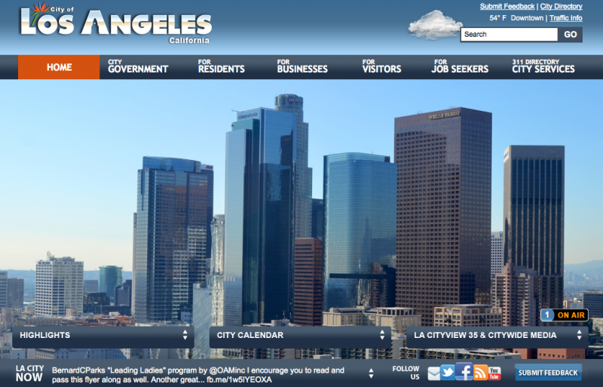
My311 Data Analysis Report
DSO 545 - Group 7
Jie Chen, Hang Cheng, Xueting Yan, Xiaoqiu Yu, Zhifeng Yu, Yiding Zhang
Dec. 2016

Slide 2
Agenda
Project Introduction
Methodology
Findings
Overall trend of requests
Why do people call 311?
When do people tend to report to 311?
How do people reach 311?
Geographic Patterns of Requests
How long does it take to process a 311 request?
Which department is in charge?
Let’s make some forecast
Recommendations

Slide 3
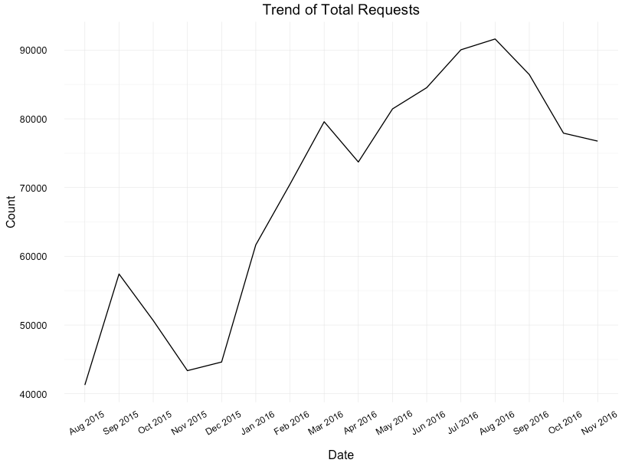
Overall trend of 311 requests
Overall, the number of service request is increasing.
Noticeably, the number of service request started to increase dramatically from Jan. 2016

Slide 4
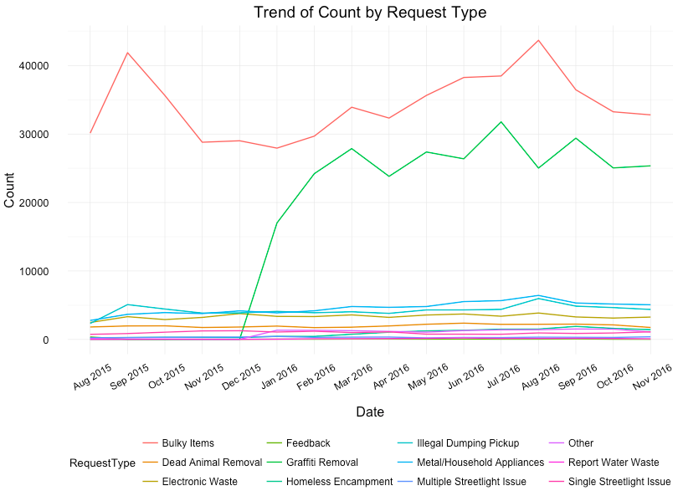
Overall trend of 311 requests
The sudden request increase is due to a newly added category “Graffiti Removal”, not a sudden increase in issue.

Slide 5
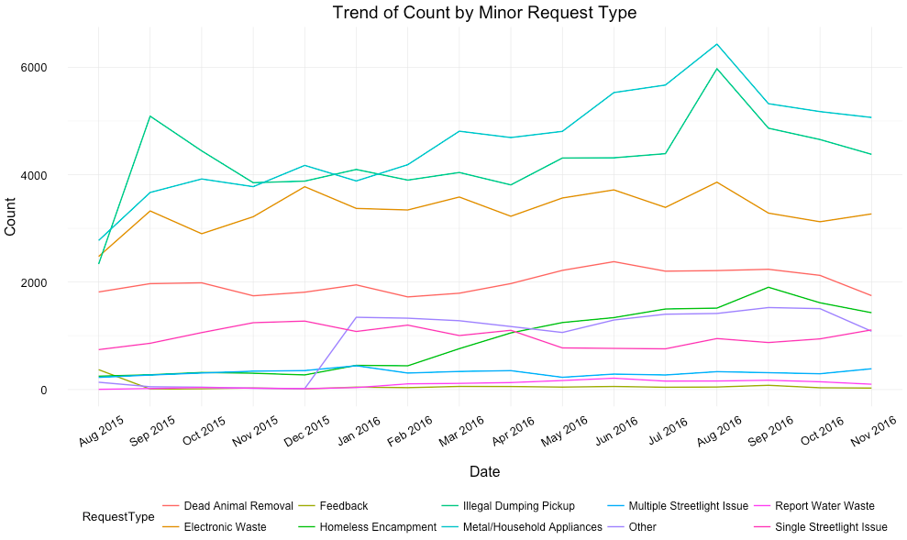
Overall trend of 311 requests
There is also an unusual growth in Others type, which we suspect may due to change of categorization.

Slide 6
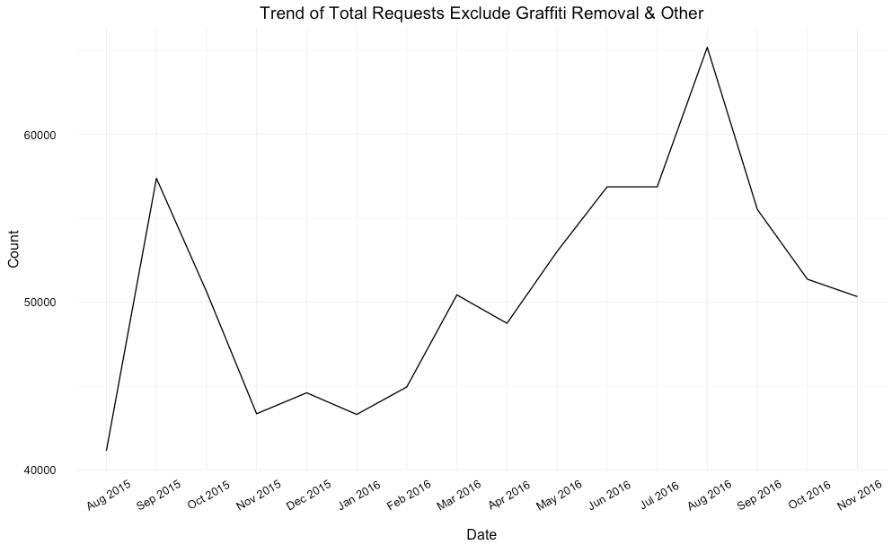
Overall trend of 311 requests
The is an approximately 12 % increase (from approximately 58k in Aug. 2015 to approximately 65k in Aug. 2016)
The potential reasons for the peaks: move-in and-out season
Notes:
3.1

Slide 7
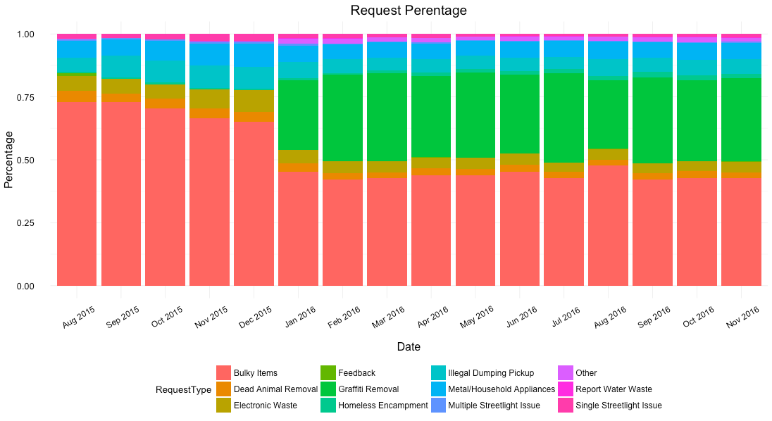
Why do people call 311?
Graffiti Removal
Bulky Items
Bulky Item and Graffiti Removal are the two mostly requested services

Slide 8
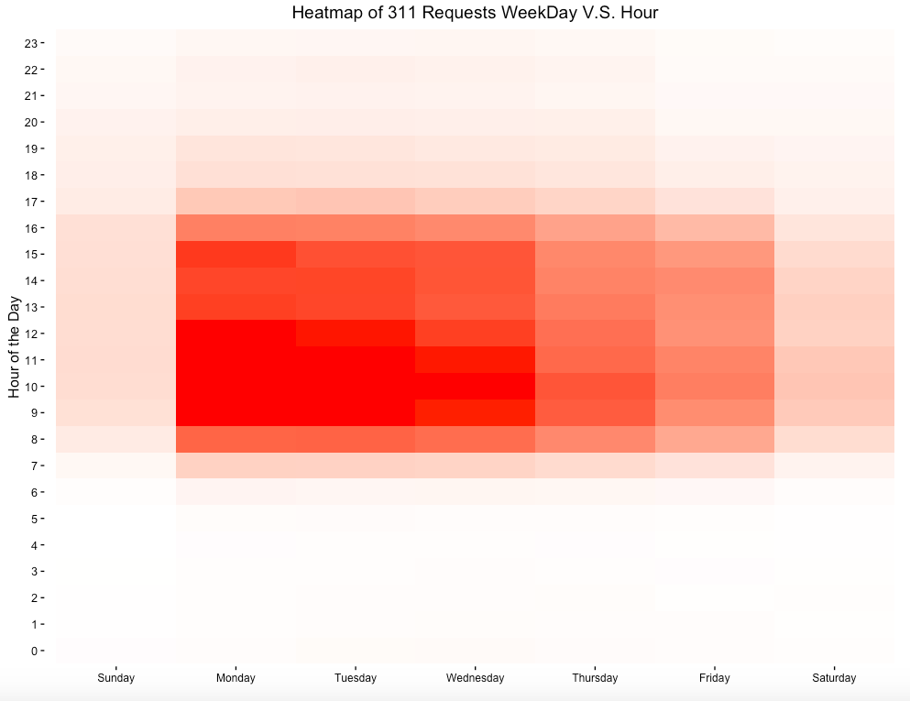
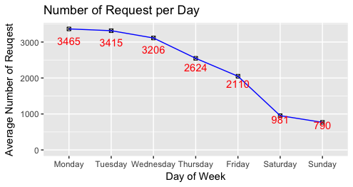
Why do people call 311?
Peaks on Mondays from 8:00am to 3:00pm, and decrease gradually in the following week days.
Notes:
3.3

Slide 9
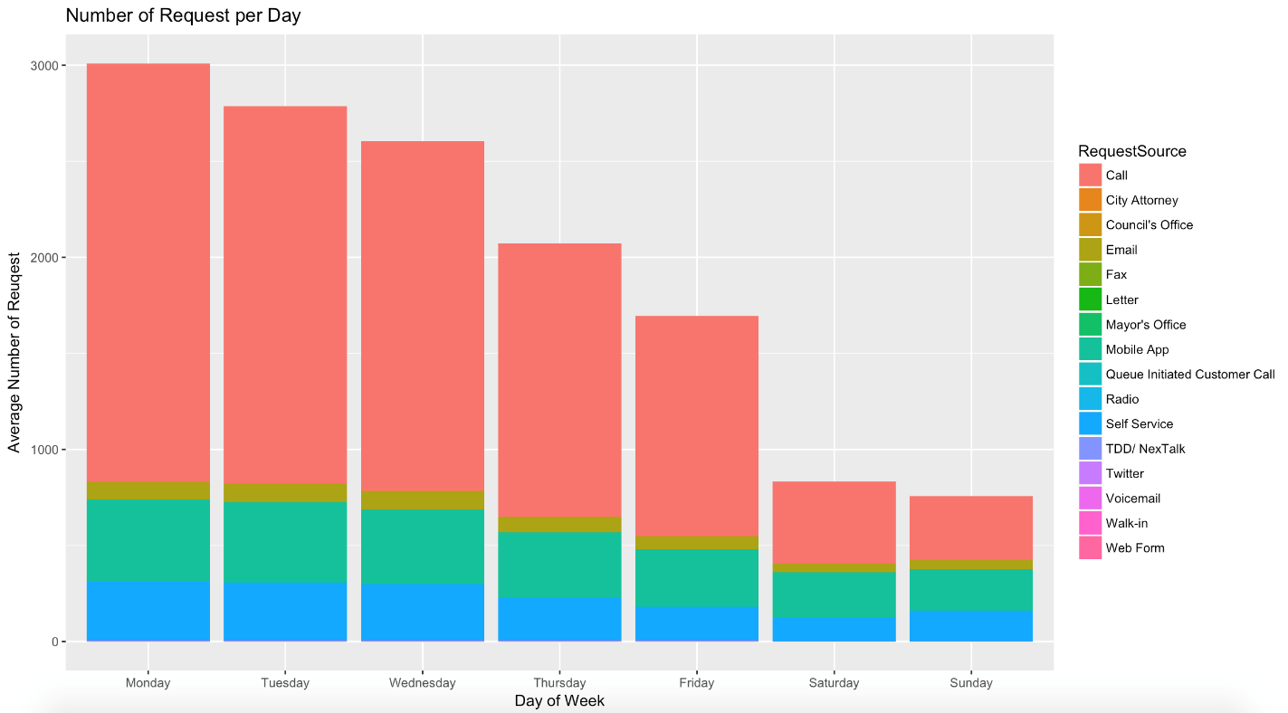
When do people report to 311?
Peaks on Mondays from 8:00am to 3:00pm
Call
Email
Mobile App
Self Service
After excluding “Driver Self Report” requests, there’s still a downward trend.

Slide 10
When do people report to 311?
People tend not to report issues during weekends through calls, but through other unattended ways.
Potential Reasons:
1) People who have requests on weekends would like to wait until Monday to report, because they might assume Call Center is closed at weekends.
2) Requests sent during weekends will be dealt together on Monday.
3) Call center is understaffed during weekends.

Slide 11
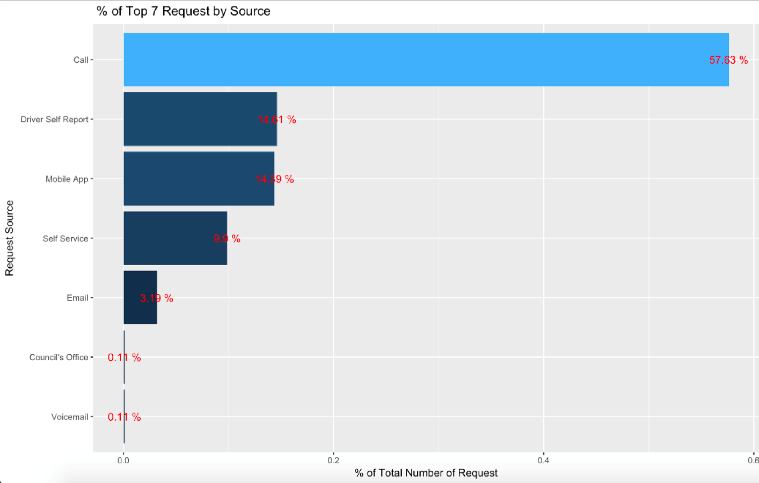
How do people reach 311?
Call is still the major channel that people reach 311, reported more than half of total requests.

Slide 12
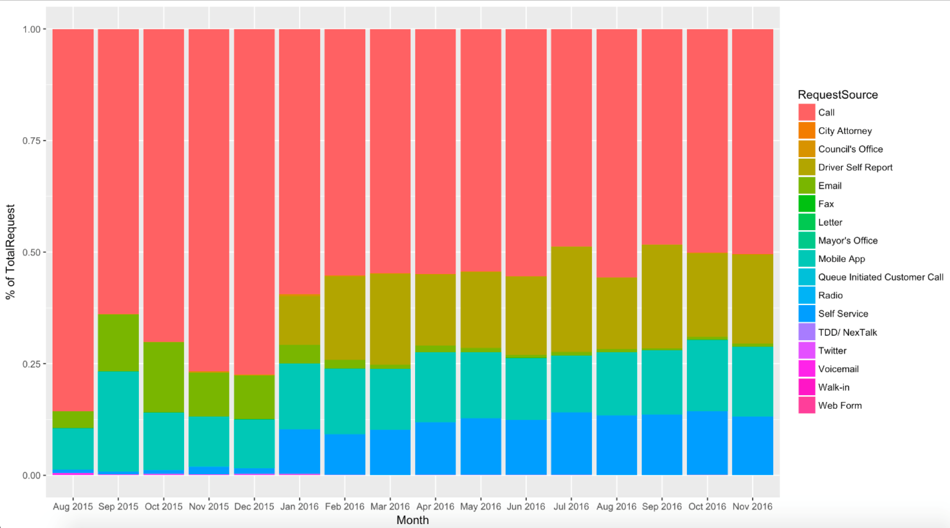
How do people reach 311?
Percentage of Request Source on Monthly Base
However, things are changing - more and more people are now using App and Self Service to submit requests.

Slide 13
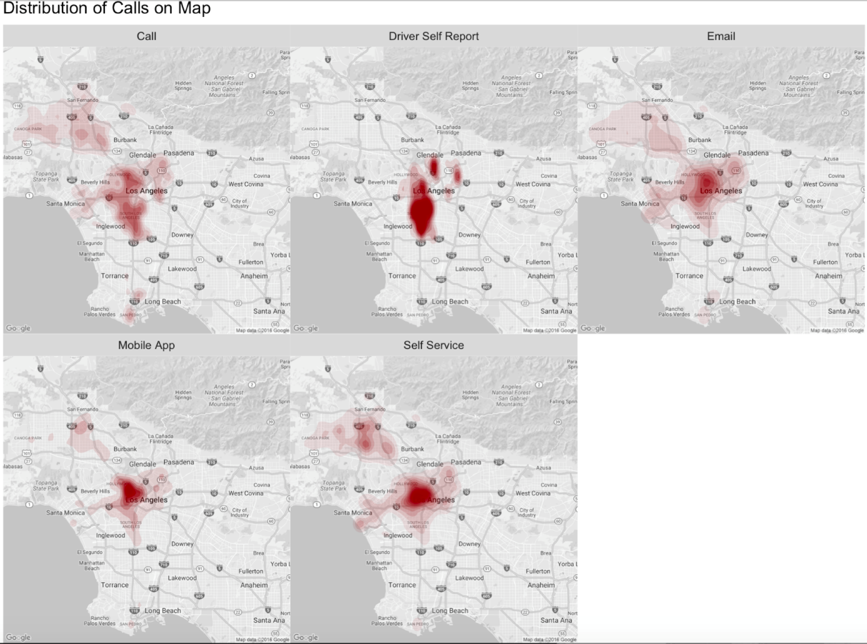
How do people reach 311?
Request Volume Distribution by Request Source
People living in downtown tend to use Email/App/Self Service more
Need to further promote these digital methods to the city.
Notes:
*remove the Driver Self Report graph

Slide 14
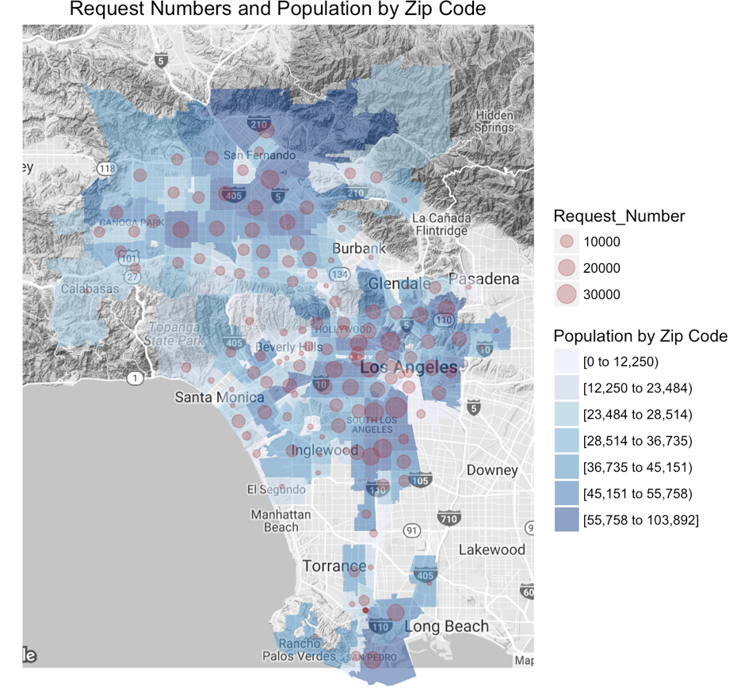
Geographic Patterns of Requests
Generally, the distribution of 3-1-1 service requests is in proportion to the population distribution.

Slide 15
Geographic Patterns of Requests
More disposal services needed for areas with more households
“Street light” issue concentrate in downtown
Notes:
1. Metal/Household Appliance, Electronic Waste, Illegal Dumping Pickup has similar distribution pattern to Bulky Items. They can be categorized as Disposal Service, and happen in area having most households.
2. Illegal dumping pickup and Homeless Encampment distribute in similar areas, maybe because homeless tends to dump illegally.
3. “Street light” issue concentrate in downtown, probably due to more nightlife and shops being more aware of streetlight issues.

Slide 16
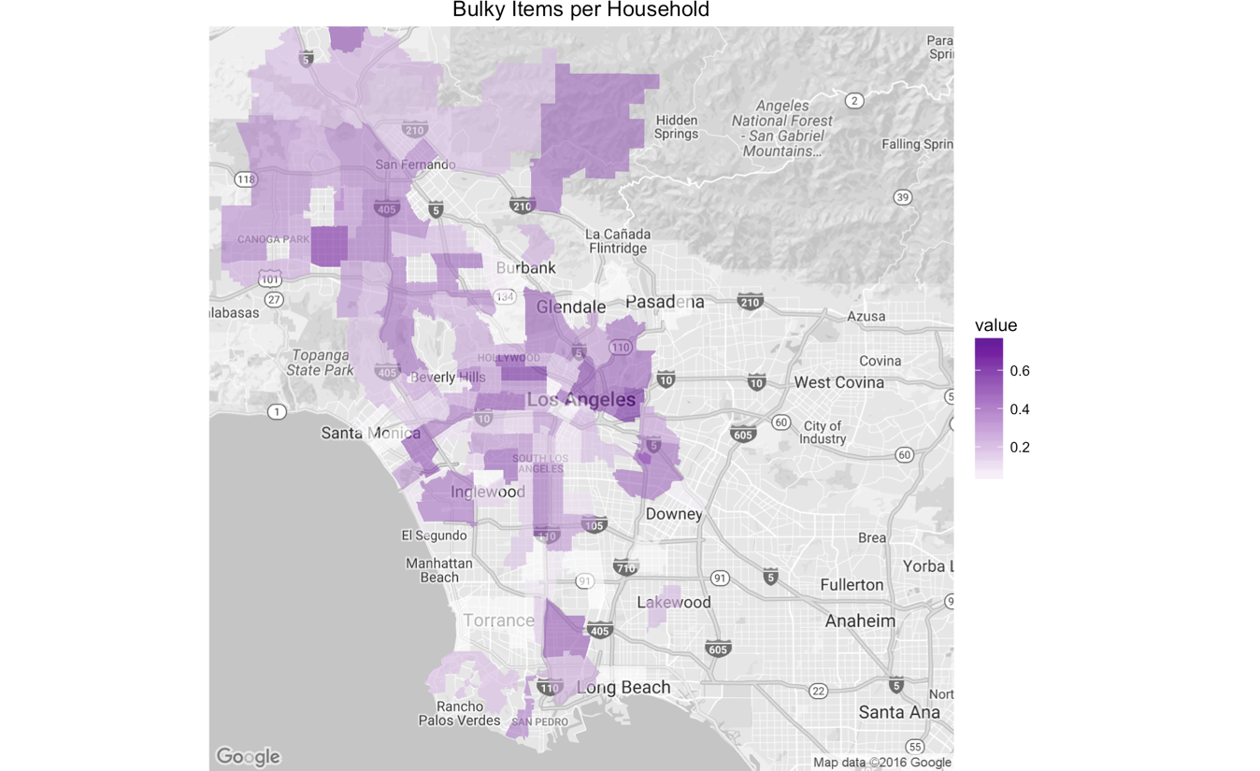
Bulky Items
UCLA
Downtown
USC
Bulky items are mostly requested from residential
Areas such as Koreatown, downtown and around universities

Slide 17
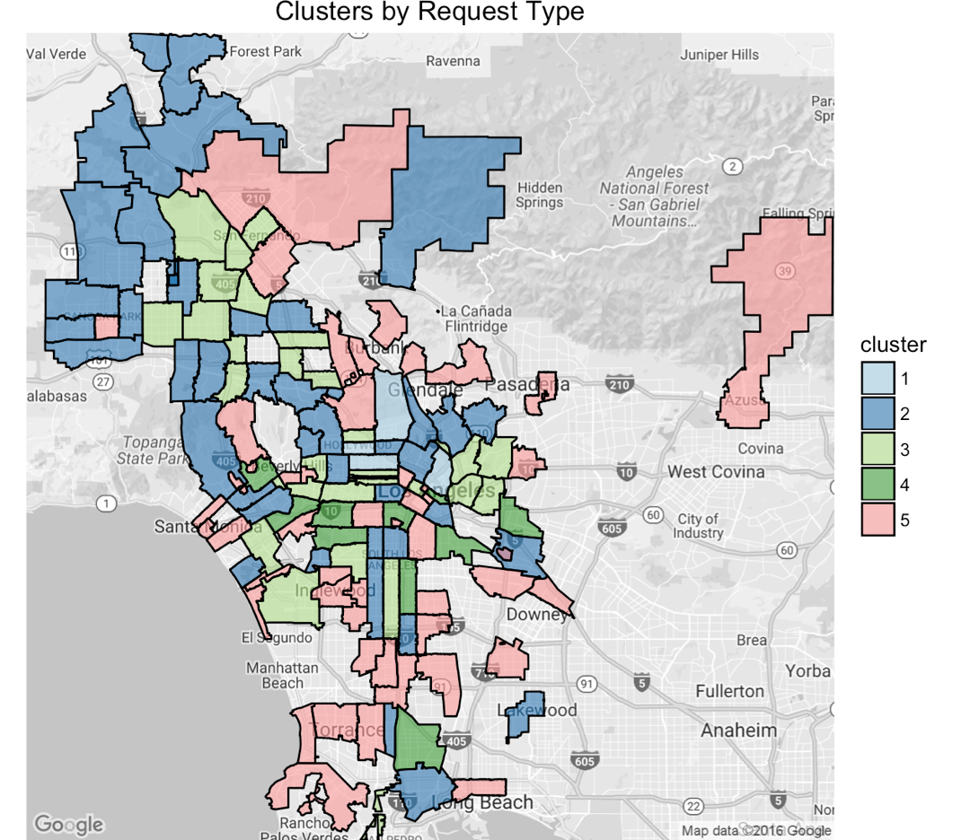
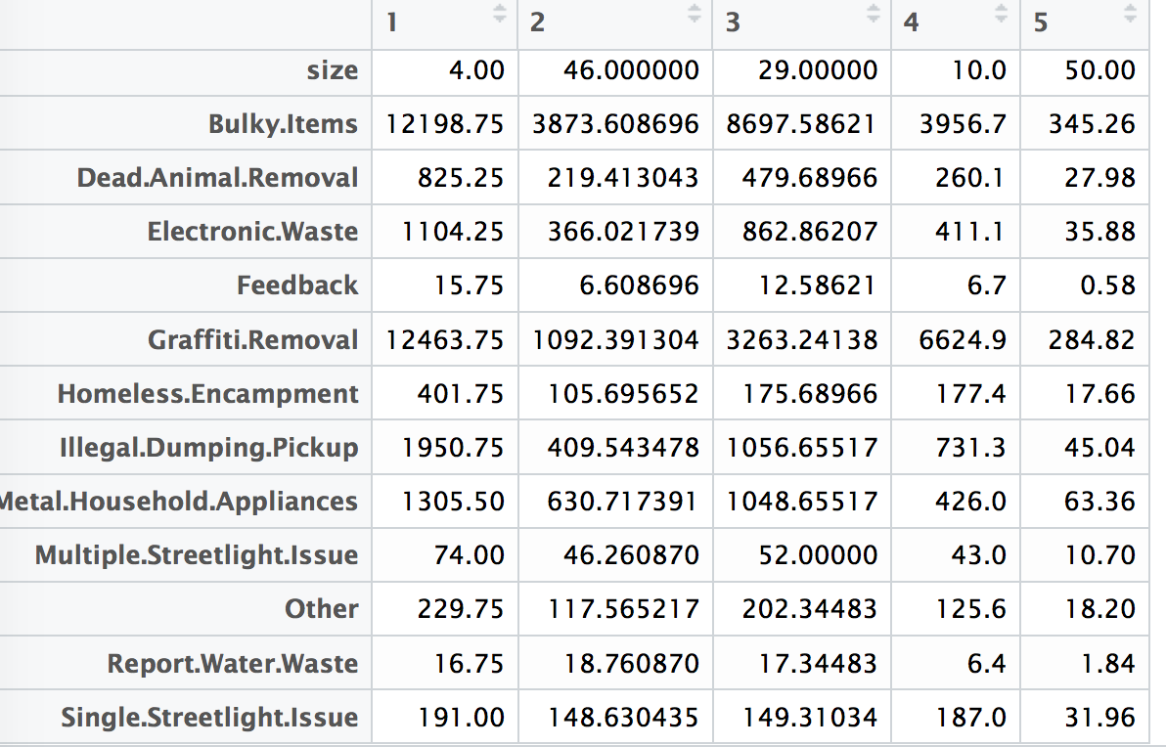
Geographic Patterns of Requests
K-means clustering: 5 clusters
Same clusters share similar magnitudes and structures of requests

Slide 18
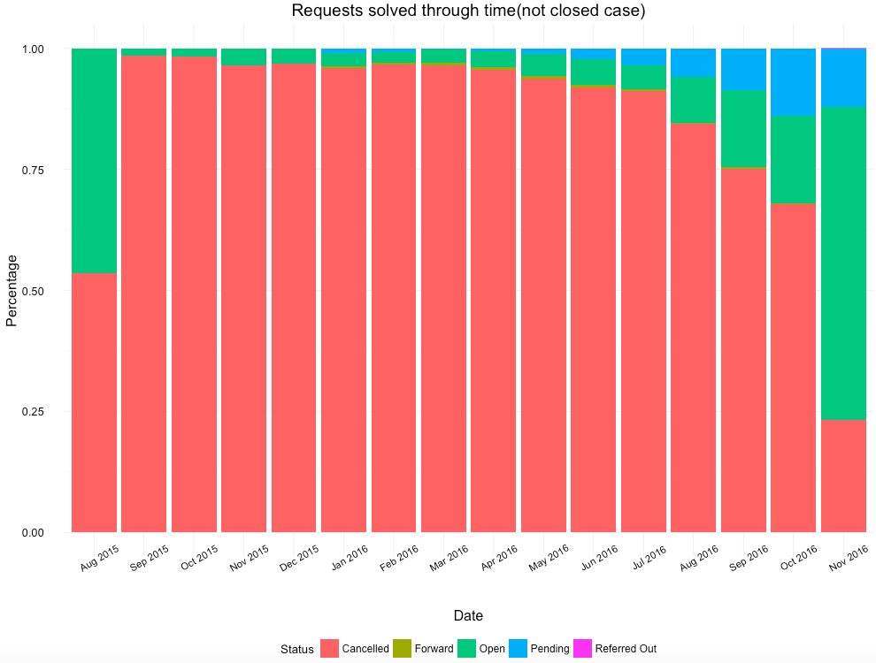
How long does it take to process a request?
Over 96% of all requests are closed
Remaining “Open” requests in Aug 2015 (which are all Feedback requests)

Slide 19
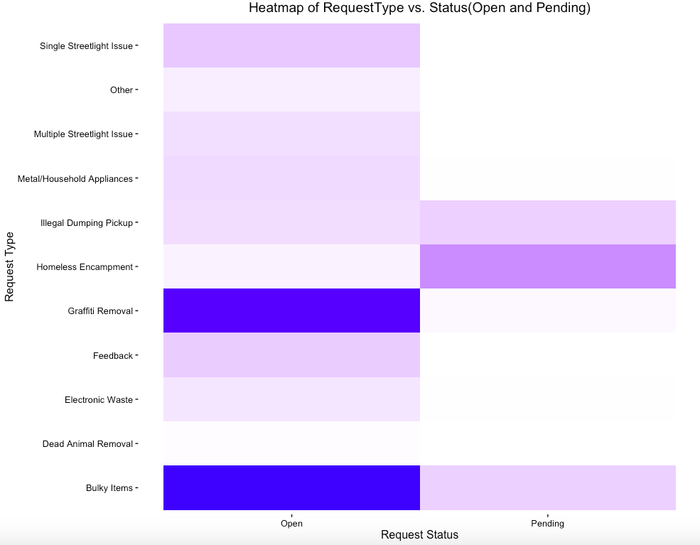
How long does it take to process a request?
Pending cases of Homeless Encampment & Illegal Dumping Pickup

Slide 20
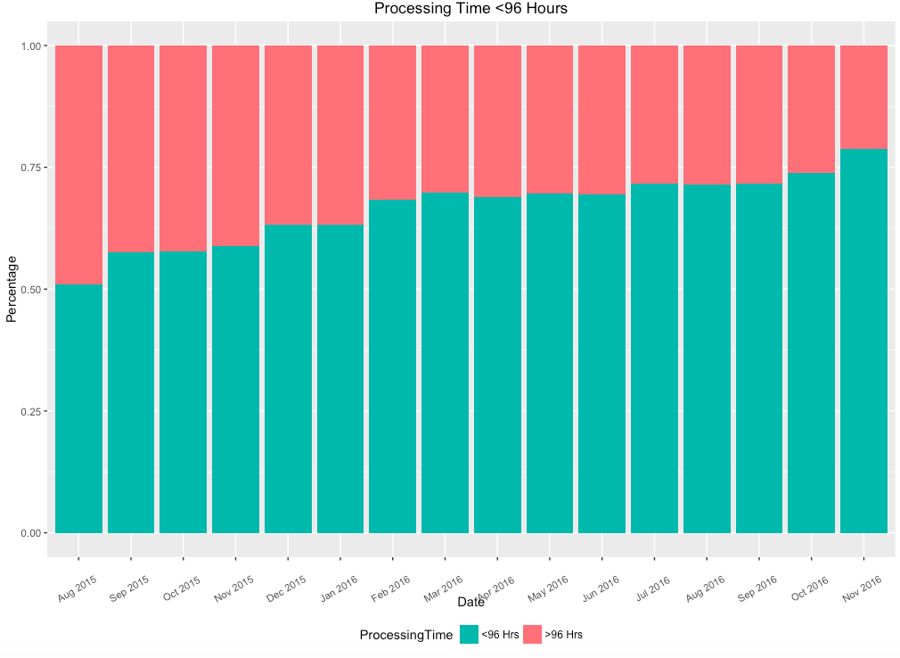
How long does it take to process a request?
As of Nov. 2016, around 75% of service requests can be solved within 96 hours (4 days)

Slide 21
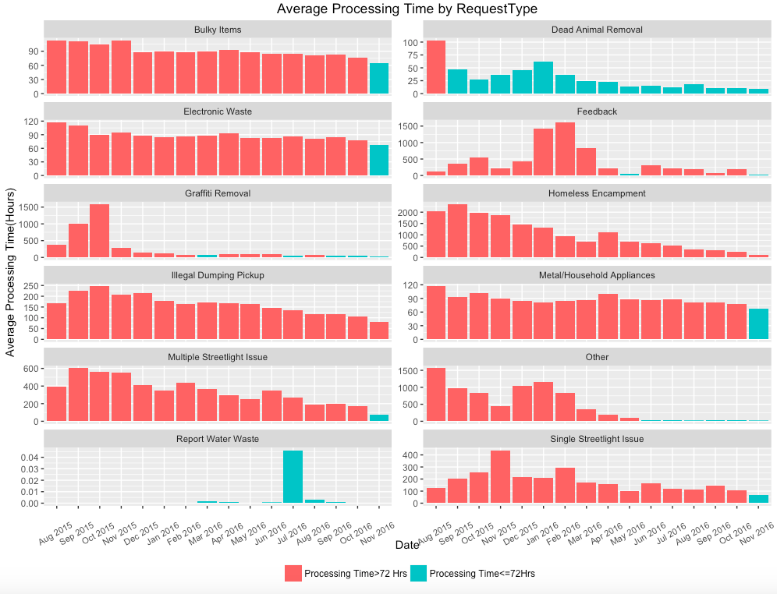
How long does it take to process a request?
Processing time for most requests types are declining into 72 hours range
Exception: Illegal Dumping Pickup & Homeless Encampment

Slide 22
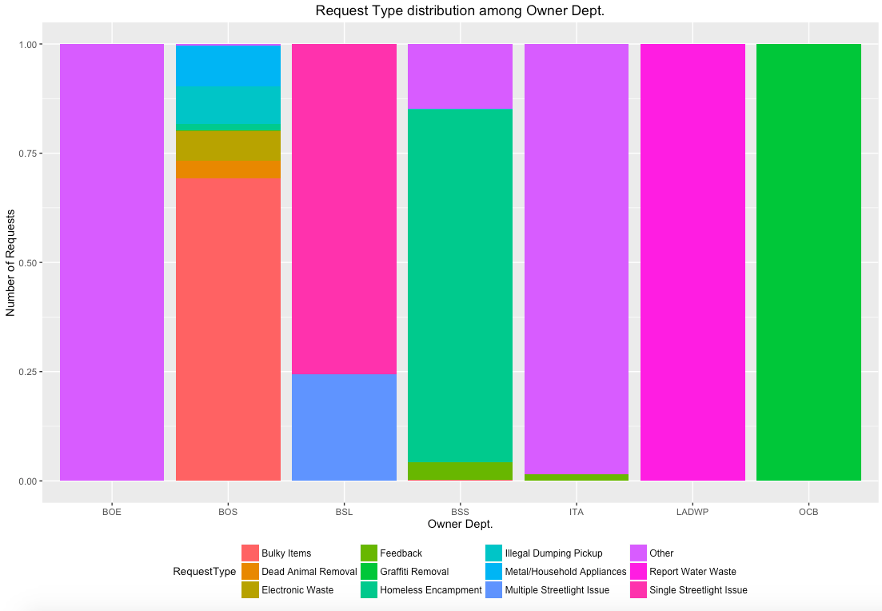
Which department is in charge?
Add more specialized category to break down “Other” requests

Slide 23
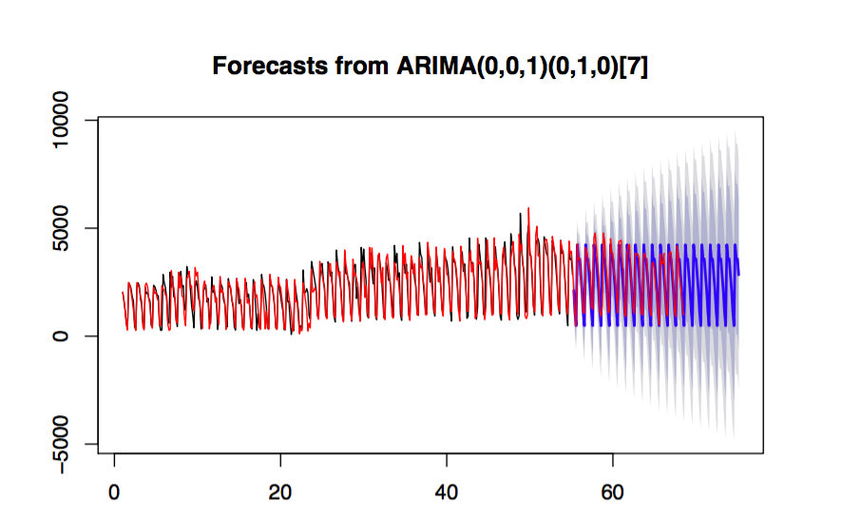
Forecasting

Slide 24
Forecasting
Total Number
Monday | Tuesday | Wednesday | Thursday | Friday | Saturday | Sunday
4238 | 3557 | 3572 | 2837 | 2127 | 1132 | 484
Bulky Item
Monday | Tuesday | Wednesday | Thursday | Friday | Saturday | Sunday
2267 | 1797 | 1692 | 1298 | 1084 | 509 | 193
Graffiti Removal
Monday | Tuesday | Wednesday | Thursday | Friday | Saturday | Sunday
1904 | 877 | 339 | 250 | 1114 | 956 | 1147
Call
Monday | Tuesday | Wednesday | Thursday | Friday | Saturday | Sunday
2410 | 2255 | 1990 | 1639 | 1309 | 489 | 792

Slide 25
Recommendations
Allocate the resources solving 311 requests in correspondence with the population density in each area.
Provide more disposal services in the area with more households.
Encourage and promote the use of MyLA311 Apps and online forms instead of phone
Add triage and category preselection functions at the time of calling
Update “Action Taken” factor with more levels
Add more specialized category to break down “Other” requests
More attention should be paid to Illegal Dumping Pickup and Homeless Encampment.
Notes:
1.Allocate the resources solving 311 requests (customer service, government specialists responsible for 311 requests from each department, etc.) in correspondence with the population density in each area.
2.Encourage and promote the use of MyLA311 Apps and online forms instead of phone calls to reduce the resources required in call center, improve the information accuracy and the quality of service.
3.Add category triage function to call auto pickup system to shorten the call processing time and keep the caller busy while waiting.
4.The “Action Taken” column need to updated in time with more comprehensive content to accumulate knowledge base for request handling and data for future analysis.
5.Provide more disposal services in the area that have more households.
6.Add more specialized category to break down “Other” requests
7.More efforts should be paid on Illegal Dumping Pickup and Homeless Encampment. Both these 2 types of request have longer processing time and higher proportion of pending cases. Also, based on our observation and assumption, these 2 requests might be internal related, we would suggest relocate more manpower and resource on solving Homeless Encampment issues first.
8.Specialization makes higher working efficiency. We would suggest a better job distribution among Owner Departments to avoid job duty overlapping, so that each department could focus more on different requests type and be more specialized.

Slide 26
Thanks! Q&A
Jie Chen: jie.chen.2017@marshall.usc.edu
Xiaoqiu Yu: Xiaoqiu.yu.2017@marshall.usc.edu
Xueting Yan: Xueting.yan.2017@marshall.usc.edu
Danny Cheng: hang.cheng.2017@marshall.usc.edu
Patrick Yu: zhifeng.yu.2017@marshall.usc.edu
Yiding (Debora) Zhang: Yiding.zhang.2017@marshall.usc.edu

